Slide 1
Types of Main Memories

Slide 2
Semiconductor Memories
Read Only Memory (ROM)
Random Access Memory (RAM)

Slide 3
RAM
Reading and writing is possible
Both are accomplished using electrical signals.
Volatile – so, used only as temporary storage.
Two techologies
  Static RAM (SRAM)
  Dynamic RAM (DRAM)

Slide 4
Dynamic RAM
Stores data as charge on capacitors
If capacitor is charged
  Data is 1
Else
  Data is 0.
Needs refreshing cycle as capacitors have a tendency of discharging.
The term dynamic refers to this tendency of the stored charge to leak away, even with power continuously applied.
Volatile
When read, data is lost. So, restoring need to be done.

Slide 5
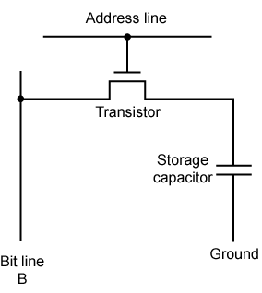
Dynamic RAM
DRAM cell
  Consists of a transistor and a capacitor.
  Transistor acts a switch
    If transistor is closed
      Allows current to flow
    Else
      No current flows

Slide 6
Dynamic RAM
Write
  Voltage signal is applied to the bit line.
    High voltage – 1
    Low voltage – 0
  Address line is activated allowing the charge to be transferred to the capacitor
Read
  Address line is activated
  Charge on capacitor is fed out onto a bit line and to a sense amplifier.
  Sense amplifier compares with reference value and determines if the cell contains 0 or 1.
  The value is restored
Used for large memory requirements

Slide 7
Static RAM
Holds the data as long as the power is supplied
Read operation don’t destroy the original data.
Expensive than DRAM but shorter cycle times.
Used for faster small memories like cache memory.
Uses 4 – 6 transistors to store a single bit of data
Less power consumption than DRAM
Complex construction
Digital
  Use flip-flops

Slide 8
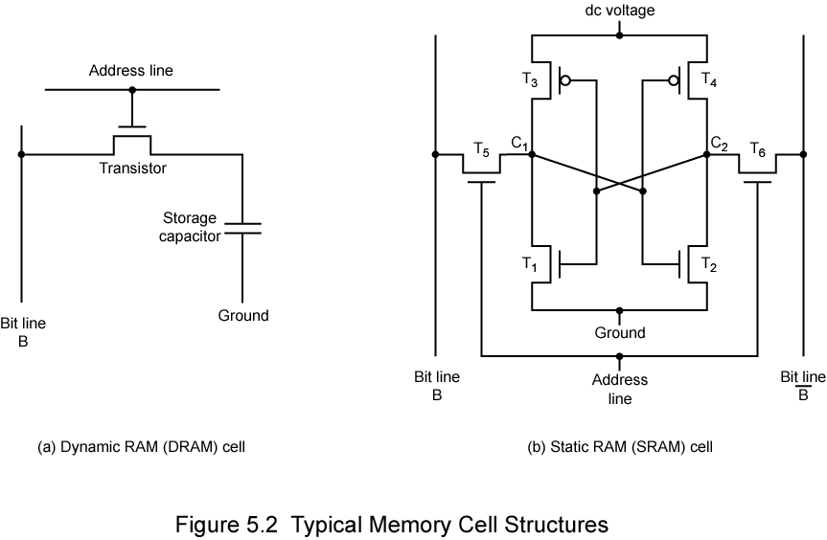
SRAM
Transistor arrangement gives stable logic state
Logic State 1
  C₁ high, C₂ low
  T₁ T₄ off, T₂ T₃ on
Logic State 0
  C₂ high, C₁ low
  T₂ T₃ off, T₁ T₄ on
Address line controls two transistors T₅ T_{6.}
When signal is applied to address line, T₅ and T₆ are on.
Write – apply value to B & complement to B
Read – bit value is read from line B

Slide 9
SRAM DRAM
Volatile - volatile
Faster - slower
smaller memory units - larger memory units
Complex construction - simpler to build
Don’t require - require refresh
refreshing circuit
Cache memory - Main memory
Larger per bit - smaller per bit
Digital - analog

Slide 10
ROM
Can only be read
Non-volatile
Secured – virus do not infect the true ROM
Applications
  Microprogramming
  Library subroutines
  System programs
  Function tables

Slide 11
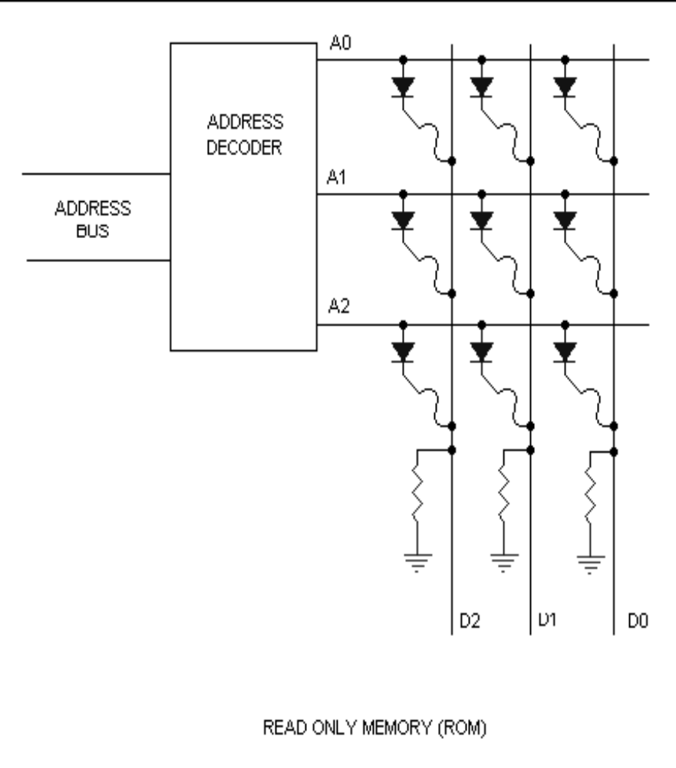
ROM
Constructed from hard – wired logic encoded in the silicon it self
If the diode is connected, it binary 1 else 0.

Slide 12
Types of ROM
Written during manufacture
  Very expensive for small runs
Programmable (once)
  PROM
  Needs special equipment to program
Read “mostly”
  Erasable Programmable (EPROM)
    Erased by UV
  Electrically Erasable (EEPROM)
    Takes much longer to write than read
  Flash memory
    Erase whole memory electrically

Slide 13
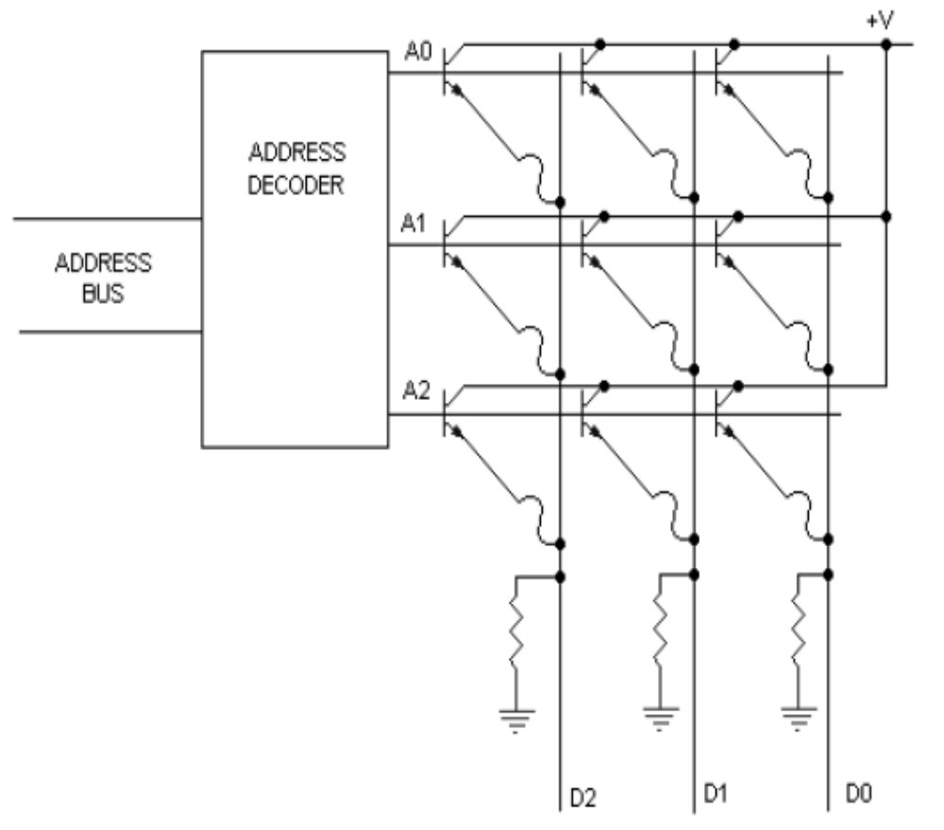
PROM

Slide 14
PROM
Programmed using a special equipment
Programming a PROM is also called as burning
PROM chips have a grid of columns and rows just as ordinary ROMs do.
The difference is that every intersection of a column and row in a PROM chip has a fuse connecting them.
Since all the cells have a fuse, the initial state of a PROM chip is all 1s.
To change the value of a cell to 0, you use a programmer to send a specific amount of current to the cell.
The higher voltage breaks the connection between the column and row by burning out the fuse.
This process is known as burning the PROM.

Slide 15
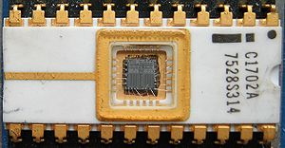
EPROM
The first EPROM, an Intel 1702, with the die and wire bonds clearly visible through the erase window.
Erasable programmable
Erased using UV rays
A little glass window is installed in the top of the ROM package, through which you can actually see the chip that holds the memory.
Ultraviolet light of a specific frequency can be shined through this window for a specified period of time, which will erase the EPROM and allow it to be reprogrammed again.
Changes cannot be made incrementally; the complete chip must be erased
Fowler-Nordheim tunneling is used to change the value

Slide 16
EEPROM
Electrically erasable programmable ROM
Commonly used for BIOS programs.
The chip does not have to removed to be rewritten.
The entire chip does not have to be completely erased to change a specific portion of it.
Changing the contents does not require additional dedicated equipment.
  Instead of using UV light, you can return the electrons in the cells of an EEPROM to normal with the localized application of an electric field to each cell.
  This erases the targeted cells of the EEPROM, which can then be rewritten.
Fowler-Nordheim tunneling is used to change the value

Slide 17
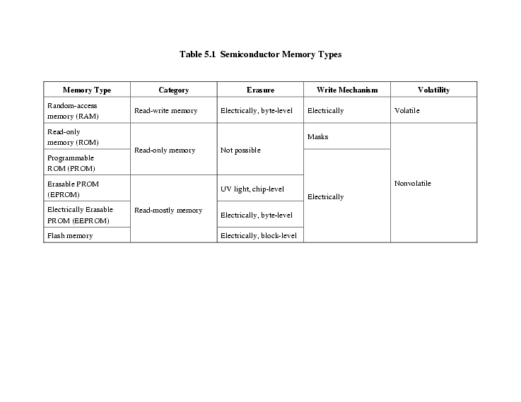
Comparison of different types of main memories

Slide 18
References
William Stallings “Computer Organization and architecture” Prentice Hall, 7th edition, 2006

